Slide 1


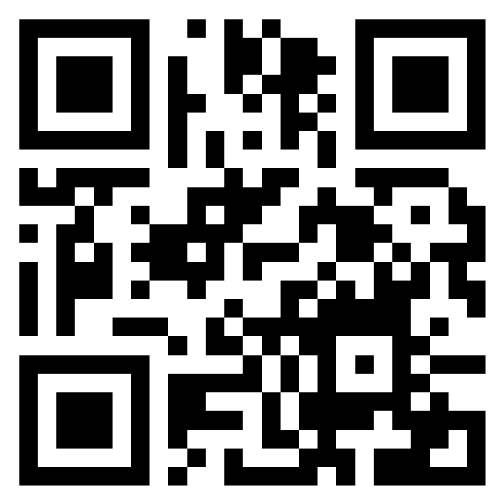
MISSING
JORDAN AVERY
AGE
29
HEIGHT
5'9"
WEIGHT
160 lbs
HAIR
brown · short
EYES
green
⚠ MEDICAL ALERT: Jordan is diabetic and needs insulin daily. (Fictional demo example.)
LAST SEEN: July 1, 2026 around 5:45 PM — Fairview Lanes bowling alley — Fairview, NJ
WEARING: Gray hoodie and jeans
VEHICLE: blue 2015 Honda Civic · Plate (Ex) 98J413N
THIS IS A DEMONSTRATION SITE — Jordan Avery is a fictional person. This is where further information would go that can help the public know more about the missing person. Examples could be places they frequently visited, or anything that might help people think of where this person might be or where to search.
$5,000 REWARD
FOR INFORMATION LEADING TO JORDAN'S SAFE RETURN
IF YOU HAVE ANY INFORMATION, CALL
222-555-0123
Fairview Police Department (fictional) — this is a demo, do not call
Updates, volunteer tasks & how to help:
demo.find-them.org
POWERED BY
Organized with Lantern Light Foundation

